Slide 1


Develhope Team Project SQL Project: Northwind Traders Team #1
Adem Aktaş
Alp Cenk Korkmaz
Barnabas Obande
Burak Abdioğlu

Slide 2






Our Journey!

Slide 3
Our Journey!
Introduction

Slide 4
Our Journey!
Introduction
Data Inconsistencies in Databases

Slide 5
Our Journey!
Data Inconsistencies in Databases
Delivery Performance Insights(Power BI)
Introduction

Slide 6
Our Journey!
Data Inconsistencies in Databases
Introduction
Delivery Performance Insights(Power BI)
Modified ER Diagram , MySQL
Migration

Slide 7
Our Journey!
Data Inconsistencies in Databases
Introduction
Delivery Performance Insights(Power BI)
Modified ER Diagram , MySQL
Migration
City Opener

Slide 8
Our Journey!
Data Inconsistencies in Databases
Introduction
Delivery Performance Insights(Power BI)
Modified ER Diagram , MySQL
Migration
City Opener
Conclusion
And Remarks

Slide 9

Introduction
Northwind Traders
1
What does our company do?

Slide 10
Introduction
Northwind Traders
1
What does our company do?
2
What is expected from us as an engineering team?

Slide 11


Introduction
Northwind Traders
1
What does our company do?
2
What is expected from us as an engineering team?
Main Objectives
Data Engineering
Data Analysis

Slide 12

Statistics show that 93% companies file for bankruptcy within one year of losing their data center and 50% companies file for bankruptcy immediately after going without any data management for a period of about 10 days.

Slide 13

Data Management Poses Major Challenges And Issues For Companies
Few of the challenges most company face is:-
Getting the most out its data
Understanding Data
Using Data Management to maximize profits
Loss of Data

Slide 14

According to:- https://pctechmag.com/
We would have expected at least Famous Companies to understand the Importance of Data Management.
NASA: In 1999, NASA took a 125 million dollar hit when it lost the Mars Orbiter. It turns out that the engineering team responsible for developing the Orbiter used English units of measurement while NASA used the metric system. Just a minimal inconsistency of data resulted in a rather costly and disastrous mistake
PAYPAL: For lack of Proper Data Management and thus preventing certain illegal transactions, PayPal had to agree to pay USD$7.7 million (£5.1 million) to the US government. It was found that nearly 500 PayPal transactions, worth almost $44,000, violated sanctions that ban US companies from doing business with individuals or organizations on a blacklist.

Slide 15
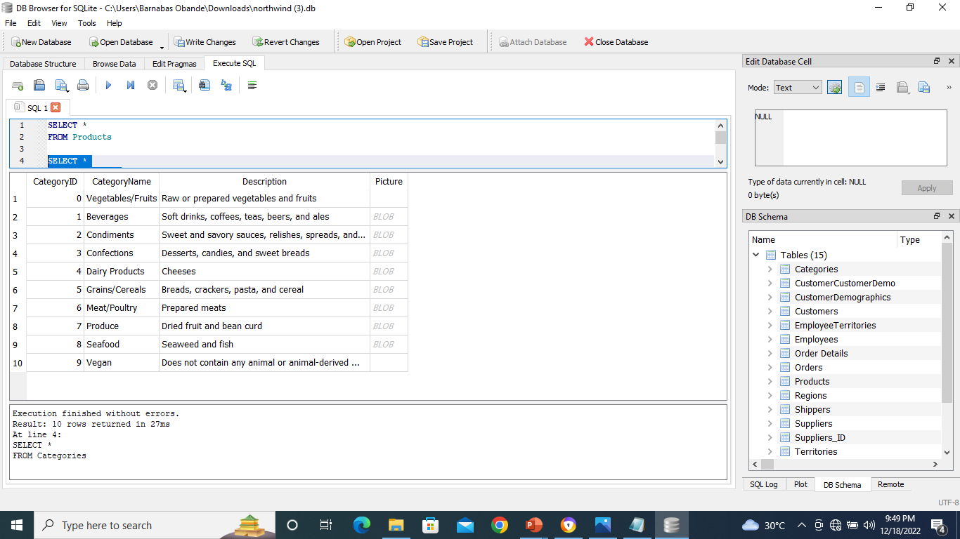
Our Team was tasked to manage Data Inconsistency and other data related issues:-
New products were added to the Database and the Category Relationship has not been respected
Our task will be to transform the inputted category names to the Category table.
Along with the new added products, there might have been newly introduced errors in some columns or some no-existing values in related tables. Tell us if there is any inconsistent data?
Solution: What we did was to fix the database by Altering the Previous Database Category table and Updating it. That is, We added the columns of the Category table that were missing.
Solution: Some products have a non-existent SupplierID. It cannot be fixed as there is missing information, but an "unknown" supplier (with all the column values set to "unknown" could be created to evade this problem

Slide 16

Every company deals with an enormous amounts of data every day. Therefore, processing it all manually is a bit unrealistic. Thus, investing in an effective data management system is not an option anymore. This has become a necessity.
After all, we should remember that it’s always better to be the company that is smart enough to learn from others’ mistakes and not the one whose mistakes teach others the lesson. Better to be safe than sorry.

Slide 17
Order, Delivery and Employee Analysis
1
Do we need to hire new employees?

Slide 18
Order, Delivery and Employee Analysis
1
Do we need to hire new employees?
2
Should we check our employees performance?

Slide 19
